Slide 1
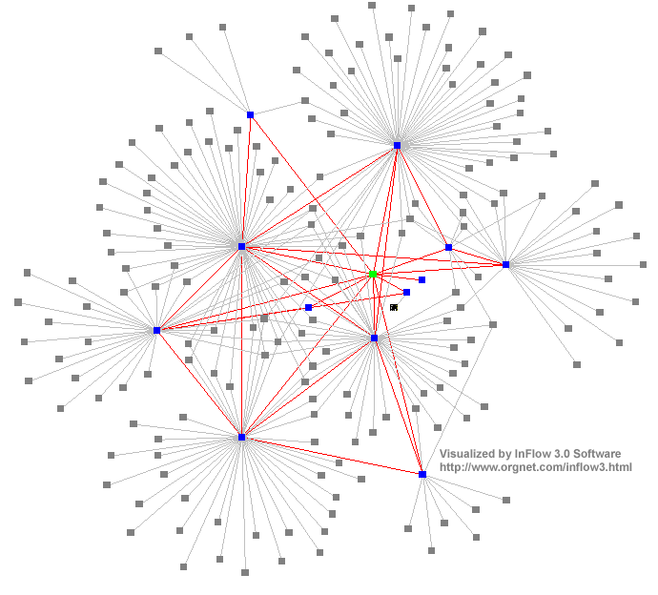
Distributed Systems :
Inter-Process Communication
Dr. Sunny Jeong. spjeong@uic.edu.hk
Mr. Bill Junru ZHONG billjrzhong@uic.edu.hk
With Thanks to Prof. G. Coulouris, Prof. A.S. Tanenbaum and Prof. S.C Joo
Notes:
35

Slide 2
Overview
Message passing
  send, receive, group communication
  synchronous versus asynchronous
  types of failure, consequences
  socket abstraction
Java API for sockets
  connectionless communication (UDP)
  connection-oriented communication (TCP)

Slide 3
API for Internet programming...
Applications, services
RMI and RPC
This
request-reply protocol
Middleware
chapter
layers
marshalling and external data representation
UDP and TCP

Slide 4
Inter-process communication
Distributed systems
  consist of Components (processes, objects) which communicate in order to co-operate and synchronize
  rely on message passing, since no shared memory
Middleware provides programming language support, hence
  does not support low-level untyped data primitives (Functions of operating system)
  implements higher-level language primitives + typed data

Slide 5
Inter-process communication ctd
Possibly several processes on each host (use ports).
Send and receive primitives.
A client node
Host(server)
node
Logical
Inter-Process
Communication
Distributed APP
Physical
Inter-Process
Communication
Communication Network
Communications System

Slide 6
Communication service types
Connectionless: UDP
  ‘send and receive(= pray)’ unreliable delivery
  efficient and easy to implement
  asynchronous communication
Connection-oriented: TCP
  with basic reliability guarantees
  less efficient, memory and time overhead for error correction
  synchronous communication

Slide 7
Connectionless service
UDP (User Datagram Protocol)
  messages possibly lost, duplicated, delivered out of order, without telling the user
  maintains no state information, so cannot detect lost, duplicate or out-of-order messages
  each message contains source address and destination address
  may discard corrupted messages due to no error correction (simple checksum) or congestion
Used for DNS (Domain Name System) on Internet, and
for rcp, rwho, RPC, HTTP(small sized), FTP(non-error bulk file)

Slide 8
Connection-oriented service
TCP (Transmission Control Protocol)
  establishes data stream connection to ensure reliable, in-sequence delivery
  error checking and reporting to both ends
  attempts to match speeds (timeouts, buffering)
  sliding window: state information includes
    unacknowledged messages
    message sequence numbers
    flow control information (matching the speeds)
Used for FTP, HTTP(bulk file), stream data, Remote login(Telnet) on Internet.

Slide 9
Timing issues in DSs
No global time
  each system has a physical clock(local time)
Computer clocks
  may have varying drift rate
  rely on GPS radio signals (not always reliable), or synchronize via clock synchronization algorithms
Event ordering (message sending, arrival)
  carry timestamps(based on global time)
  may arrive in wrong order due to transmission delays (cf email)

Slide 10
Failure issues in DSs
DSs expected to continue if failure has occurred:
  message failed to arrive
  process stopped (and others may detect this process)
  process crashed (and others cannot detect this process)
Types of failures
  Benign (tolerable)
    omission, stopping, timing/performance
  arbitrary (called Byzantine)
    corrupt message, wrong method called, wrong result

Slide 11
Omission and arbitrary failures
Class of failure
Affects
Description
Fail-stop
Process
Process halts and remains halted. Other processes may
detect this state.
Crash
Process
Process halts and remains halted. Other processes may
not be able to detect this state.
Omission
Channel
A message inserted in an outgoing message buffer never
arrives at the other end’s incoming message buffer.
Send-omission
Process
A process completes a
send,
but the message is not put
in its outgoing message buffer.
Receive-omission
Process
A message is put in a process’s incoming message
buffer, but that process does not receive it.
Arbitrary
Process
or
Process/channel exhibits arbitrary behaviour: it may
(Byzantine)
channel
send/transmit arbitrary messages at arbitrary times,
commit omissions; a process may stop or take an
incorrect step.

Slide 12
Types of interaction
Synchronous interaction model:
  known upper/lower bounds on execution speeds, message transmission delays and clock drift rates
  more difficult to build, conceptually simpler model
  use Queue(for waiting)
  send and receive are blocking
Asynchronous interaction model
  arbitrary processes execution speeds, message transmission delays and clock drift rates
  some problems impossible to solve (e.g. agreement)
  Send is non-blocking, receive is blocking or non-blocking
  if solutions valid for asynchronous, then also valid for synchronous.

Slide 13
Send and receive
msg
Send
  send a message to a socket bound to a process
  can be blocking or non-blocking
Receive
  receive a message on a socket
  can be blocking or non-blocking
Broadcast/multicast
  send to all processes or all processes in a group

Slide 14
Receive
Blocked receive
  destination process blocked until message arrives
  most commonly used
Variations
  conditional receive (continue until receiving indication that message arrived or polling)
  timeout
  selective receive (wait for message from one of a number of ports)
Communication
type
Blocking
Send
Blocking
Receive
Languages and
systems
Synchronous
Asynchronous
Asynchronous
Yes
No
No
Yes
Yes
No
occam
Mach, Chorus
BSD 4.x UNIX
Charlotte

Slide 15
Asynchronous Send
Characteristics:
  unblocked (process continues after the message sent out)
  buffering needed (at receive end)
  mostly used with blocking receive
  usable for multicast
  efficient implementation
Problems
  buffer overflow
  error reporting (difficult to match error with message)
Maps closely onto connectionless service.

Slide 16
Synchronous Send
Characteristics:
  blocked (sender suspended until message received)
  synchronization point for both sender & receiver
  easier to reason about Synchronous Send
Problems
  failure and indefinite delay causes indefinite blocking (Use: Timeout)
  multicasting/broadcasting not supported
  implementation more complex
Maps closely onto connection-oriented service.

Slide 17
Sockets and ports
  Socket = Internet address + port number.
  Only one receiver, but multiple senders per port.
  Disadvantages: location dependence (Cf. Mach)
  Advantages: several points of entry to the process
  Port No(= 2**16 numbers, /etc/services )
1-255: standard services, 21: ftp, 23 : telnet, 25: e-mail, 513 : login
1-1023: only system processes
1024-4099 : system and user processes,
5000< : only user processes
any port
agreed port
socket
socket
message
client
server
other ports
Internet address = 138.37.94.248
Internet address = 138.37.88.249

Slide 18
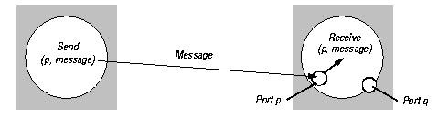
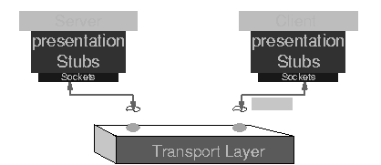
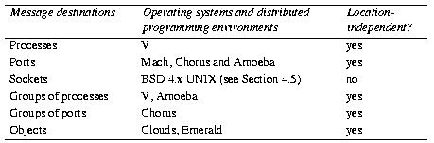
Sockets
Detailed Socket
Message destinations
V : V-kernel
MS windows : winsock

Slide 19
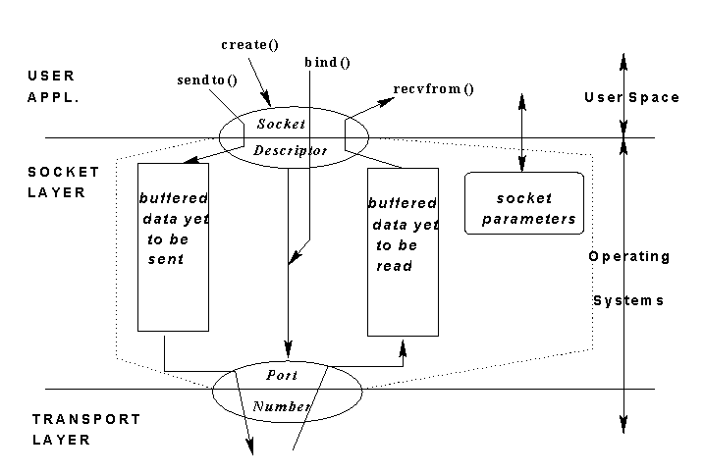
Sockets ctd
Socket Layer
Characteristics:
  Endpoint for
  inter-process communication
  message transmission
  between sockets
  socket associated with
  either UDP or TCP
  processes bound to sockets
  can use multiple ports
  no port sharing unless IP multicast
Implementations
  Originally BSD Unix, but available in Linux, Windows(C language)
  Windows Socket API
  Java API for Internet programming

Slide 20
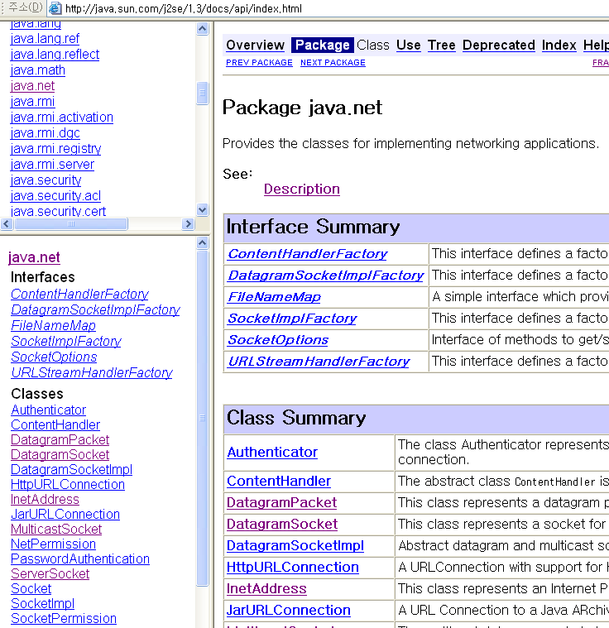
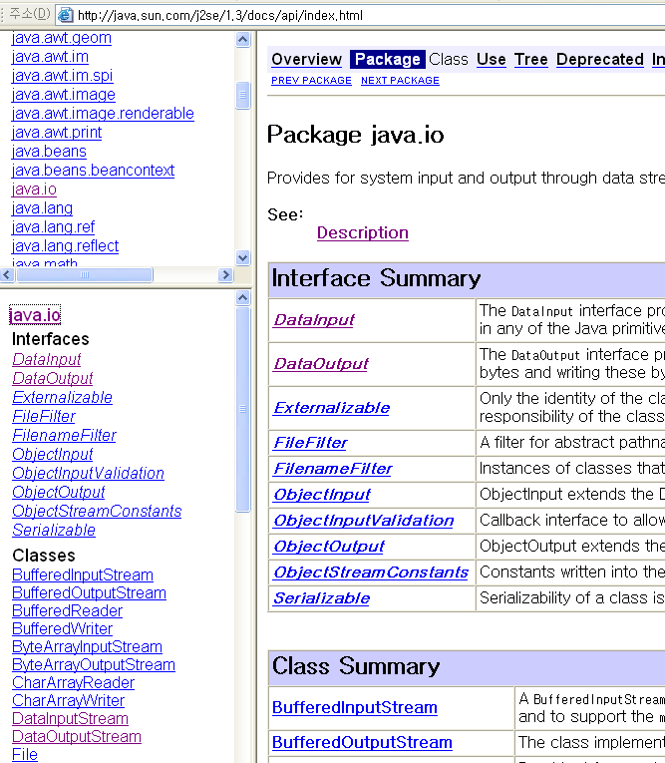
Packages : Java.net, Java.io

Slide 21
Java API for Internet addresses
JavaTM 2 Platform
Std. Ed. v8
  Class/Methods Ref.➔
  http://docs.oracle.com/javase/8/docs/api/
Class InetAddress
  uses DNS (Domain Name System)
  InetAddress aC = InetAddress.getByName( “gromit.cs.bham.ac.uk” );
  throws UnknownHostException
  encapsulates detail of IP address (4 bytes for IPv4, and 16 bytes for IPv6)

Slide 22
Java API for Datagram Comms(UDP)
Simple send/receive, with messages possibly lost/out of order
Class DatagramPacket
  packets may be transmitted between sockets
  packets truncated if too long
  provides methods(getData, getPort, getAddress…)
message (=array of bytes) | message length | Internet Addr | port No

Slide 23
Java API for Datagram Comms ctd
Class DatagramSocket
  socket constructor (returns free port if no arg.)
  send DatagramPacket, non-blocking
  receive DatagramPacket, blocking
  setSoTimeout (receive blocks for time T and throws InterruptedIOException)
  connect
  close DatagramSocket
  throws SocketException if port unknown or in use

Slide 24
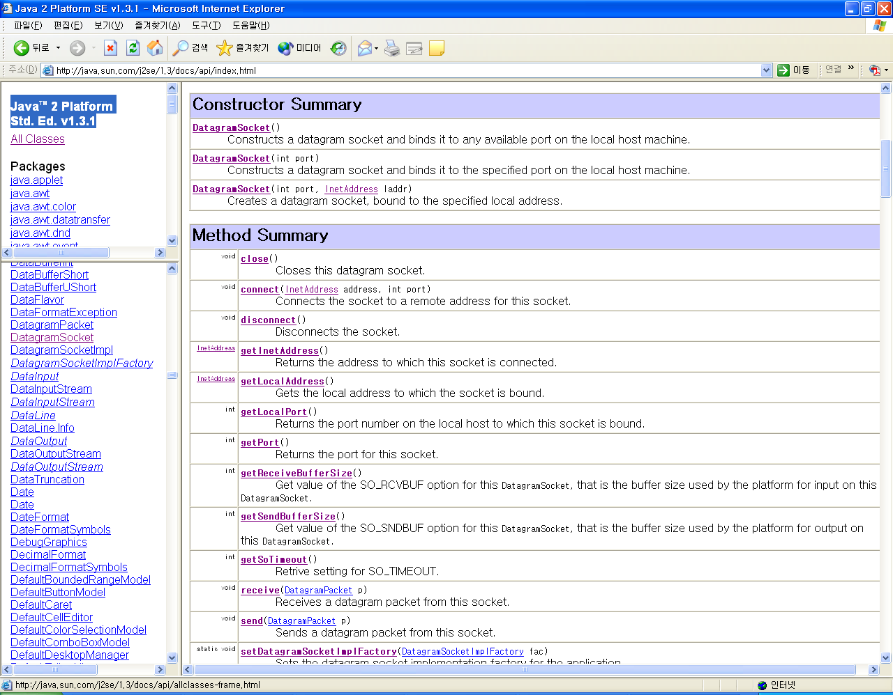
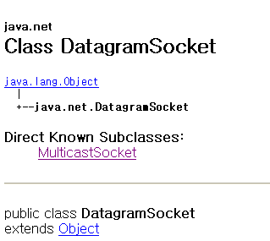
Java API for Datagram Comms( ex: DatagramSocket class)

